Slide 1
Quality and Patient Safety Council
Performance Report
Name of the Department
Presenter Name
Department Name
Date

Slide 2
Quality Improvement Goals and Objectives
The ----------------------services QI program will influence all processes related to services to patients. These processes may include but are not limited to:
Clinical process and outcomes performance indicators
Investigation of adverse events
Performance improvement and patient safety projects (PDSAs and/or DMAICs)
Patient perspectives
Maintain certifications and licensures/ Regulatory standards compliance
Resource utilization
7. Summary

Slide 3
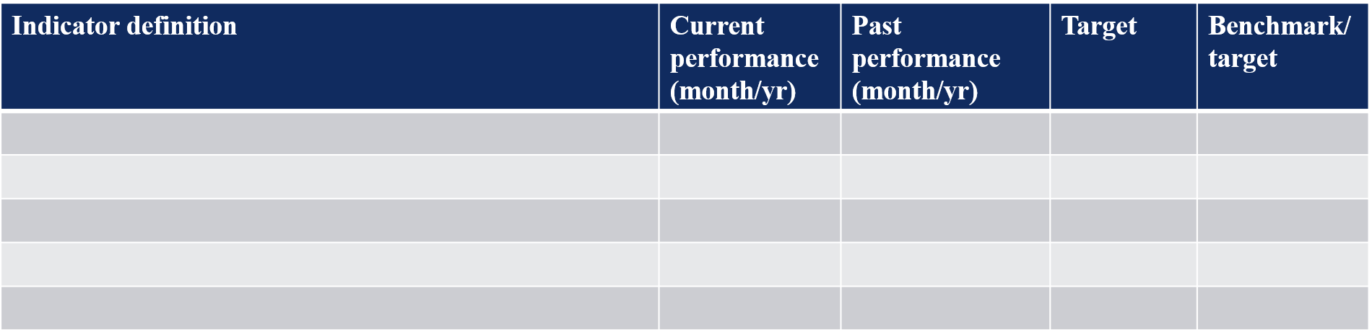
Performance Indicators
Clinical Process and Outcomes
List all performance indicators with benchmarks and target…..Highlight if dept uses any registries or manages data in house for performance standards.
EXAMPLE: STS CT Sx, GWTG Stroke program, SRTR for transplants etc.

Slide 4
Adverse Events Identification, Reporting, Analysis and Prevention
Any particular event that you’d like to present to the members…
What issues are unresolved?
*Adverse Event (AE) is defined as an untoward, undesirable, and usually unanticipated event that causes death or serious injury, or the risk thereof. The phrase “risk thereof” includes any process variation for which an occurrence would carry a significant chance of serious adverse outcome. A Serious Safety Event (SSE) is defined as a deviation from generally accepted practice standards that reaches the patient and results in moderate to severe physical or psychosocial harm and/or death. If an event is deemed to be an SSE appropriate cause analysis will then occur which is led by the QM Department. Events meeting the definition of an SSE undergo a Root Cause Analysis (RCA). Events not reaching that threshold, but which may present any process variation or outcome for which a repeat occurrence could carry an elevated risk of harm to patients would undergo an Apparent Cause Analysis (ACA).

Slide 5
Performance Improvement
PDSA or DMAIC (see addendum on which one to pick? )
Process improvement projects that focus on high-risk, high-volume activities and areas that are potentially problem-prone. Performance improvement projects are approved and/or monitored by local departmental leaders and reflect the scope and complexity of the Laboratory services program’s services and operations.
You can use this resource to learn about the PDSA format
https://www.youtube.com/watch?v=xzAp6ZV5ml4
You can also use the DMAIC (DEFINE MEAUSRE ANALYZE IMPROVE & DCONTROL for any process improvements you are doing)
https://www.youtube.com/watch?v=TzPPuvciE-Y

Slide 6
PLAN
DO
STUDY
ACT
I plan to: Here you will write a concise statement of what you plan to do in this testing. This will be much more focused and smaller than the implementation of the tool. It will be a small portion of the implementation of the tool.
I hope this produces: Here you can put a measurement or an outcome that you hope to achieve. You may have quantitative data like a certain number of doctors performed teach-back, or qualitative data such as nurses noticed less congestion in the lobby.
Steps to execute: Here is where you will write the steps that you are going to take in this cycle. You will want to include the following:
The population you are working with—are you going to study the doctors' behavior or the patients' or the nurses'?
The time limit that you are going to do this study—remember, it does not have to be long, just long enough to get your results. And, you may set a time limit of 1 week but find out after 4 hours that it doesn't work. You can terminate the cycle at that point because you got your results.
After you have your plan, you will execute it or set it in motion. During this implementation, you will be keen to watch what happens once you do this.
What did you observe? Here you will write down observations you have during your implementation. This may include how the patients react, how the doctors react, how the nurses react, how it fit in with your system or flow of the patient visit. You will ask, "Did everything go as planned?" "Did I have to modify the plan?"
Study results – analyze and study data. Compare results to predictions.
What did you learn? Summarize quantitative and qualitative analysis.
Quantitative: Which way is the experience moving – up, down or static over time? Is this desirable or undesirable?
Qualitative: Why is this happening? Consider all reasons. What are the contributing factors? What does this mean?
What did you conclude from this cycle review?
Refine the change based on what was learned from the do/study.
Did the implementation work or not?
If it did not work, what can you do differently in the next cycle to address this?
If it did work, can you spread across an entire practice?
Should this continue to be measured? Should another indicator be introduced?

Slide 7
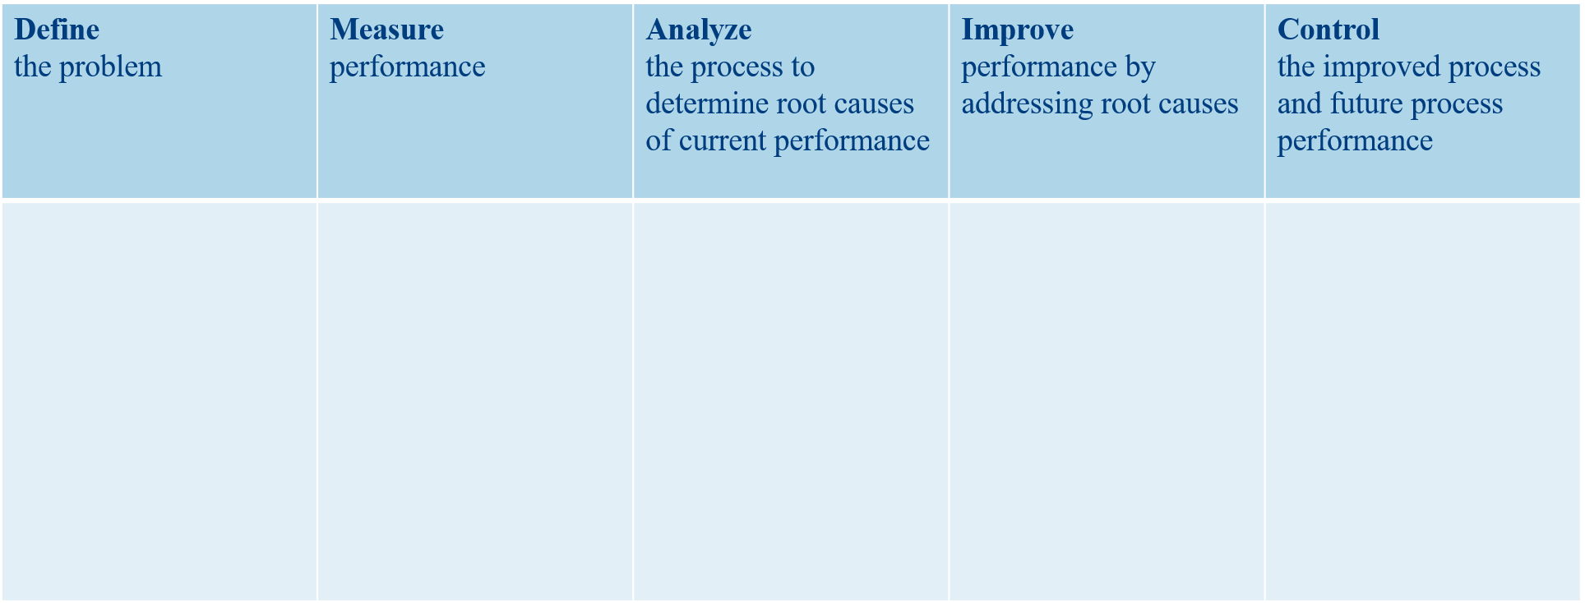
or use DMAIC
Or use DMAIC

Slide 8
Patient Perspectives
Complaints
Patient Satisfactions surveys
Commendations – any thank you letters from patients

Slide 9
Regulatory Compliance With Accrediting Bodies
Data for compliance with regulatory bodies/ registries?
Any upcoming surveys?

Slide 10
Resource Utilization
List any issues and successes with resource utilization operational issues that may hinder with pt. safety and performance improvement(OPTIONAL)
Adequacy of staffing;
Staffing (RN coordinators, others) ,
FMLA use (or abuse) – just some insights or numbers.. whatever you can get.
nurses’ education,
skill-mix and
workload (can mention volume increase)

Slide 11
Summary
Achievements: Opportunity to shine and celebrate wins
Barriers: Share any barriers you are currently facing to inform or seek guidance from the committee

Slide 12
Questions?

Slide 13
Addendum
Fiscal Year 2025 QAPI and Patient Safety Plan Priority Objectives
1. Safety
a. Optimize implementation of Epic Electronic Health Record
b. Patient safety indicators (PSIs)
  i. Maintain pressure ulcers (PSI03) to below Vizient comparison (* Due to conversion to and re-certification process with new UTMC EMR, benchmarking data might be delayed)
  ii. Maintain postoperative respiratory failure (PSI11) to below Vizient comparison
  iii. Maintain perioperative pulmonary embolism and deep vein thrombosis rate (PSI12) to below Vizient comparison
  iv. Maintain postoperative sepsis rate (PSI13) to below Vizient comparison
c. Healthcare-associated infections
  i. Maintain the surgical site infection rate reported to the Center for Disease Control-National Healthcare Safety Network (CDC-NHSN) below the established standardized infection rate (SIR) threshold
  ii. Decrease the catheter-related blood stream infection rate below the CDCNHSN SIR established threshold
  iii. Maintain the catheter-associated urinary tract infection rate below the CDCNHSN SIR established threshold
  iv. Maintain the Clostridium difficile infection rate below the CDC-NHSN SIR established threshold
  v. Maintain methicillin-resistant S. aureus blood stream infections below CDCNHSN SIR established threshold
d. Improve hand-hygiene observations to achieve an overall average above 90%
e. Maintain service line specific mortality rates below Vizient index
f. Decrease UTMC overall mortality rate below Vizient Index
g. Improve Leadership/management Promoting Patient Safety Measured via AHRQ Culture of Safety Survey question.
h. Improving diagnostic performance to reduce harm and improve health outcomes (specifically in Radiology and Pathology)
i. Develop and implement procedure-specific Surgical Appropriateness Criteria intended for surgeons to use to evaluate whether the patient is appropriate for surgery. At a minimum to cover the following procedures: Carotid endarterectomy, Mitral valve repair and replacement, Bariatric surgery for weight loss, Total knee replacement and Total hip replacement. Retrospective reviews of surgical cases to evaluate compliance to the criteria will be undertaken by individual departments. Any trend or pattern suggesting challenges adhering to your appropriateness criteria will be reported to the surgical leadership who will then work to understand potential barriers to meeting the criteria

Slide 14
Continued Objectives
2. Access
  a. Maintain Emergency Department (ED) average (median) time patients spent in the
  emergency department before leaving from the visit below national rate as reported
  in the CMS Outpatient Quality reporting program (publicly reported on the CMS
  hospital compare reports)
3. Effectiveness
  a. Maintain UTMC overall 30-day readmission rate below Vizient average median.
  b. Reduce total Medicare spending per beneficiary spent index to below 1 by reducing
  discharges to Senior Nursing facilities.
  c. Patient reported outcomes performance measures for Hip and knee replacement –
  Track patient reported data for total hip and knee replacement Medicare population.
  (at least 50% of the population)
4. Efficiency
  a. Improve annual OR on-time start percentage to above 85% for UTMC surgical services
  b. Improve annual OR turnaround time of less than 30 minutes.
  c. Improve overall UTMC clinical documentation capture of Medicare Severity Diagnosis
  Related Groups (MS-DRGs) complication or comorbidity (CC) or a major complication
  or comorbidity (MCC) (i.e., MS-DRG CC/MCC), improving CMI by 10% from FY 2023
  d. Reduce risk adjusted Length of Stay to at or below Vizient median for the AMC
  comparable cohort.
5. Equitable
  a. Meet and exceed the Health Care Equity Standards (and NPSG) set out by the joint
  commission.
  b. Improve and maintain rank in the top 25 best performers in the benchmarking cohort
  for Vizient equity score (for gender and race in Sepsis, STEMI).
6. Patient-centeredness- improve to 50th percentile in the following domains: Ambulatory
Surgery, Emergency Department, Inpatient service, and Outpatient Medical Practice.
7. Maintain accreditation and certification readiness.

Slide 15
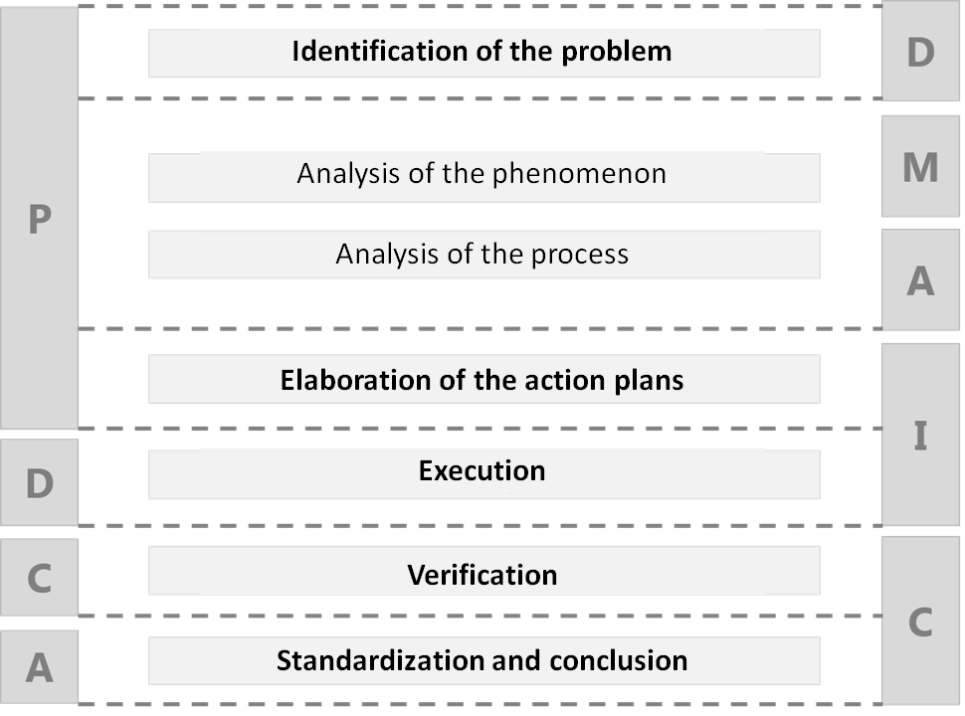
PDSA vs DMAIC
Which one to pick?
PDSA
Works Well for Iterative processes
It’s designed to work in a feedback loop, constantly using the results of the last iteration as input for the next one, and it can work especially well when you are planning to run some process that promotes change for a very long period of time.
DMAIC
Is great for Data-Driven projects
It is a more refined tool, more effort on understanding the problem. You’ll want to ensure that you always have enough data to work with.
Planning: The Road to Success
"If I had an hour to solve a problem and my life depended on the solution, I would spend the first 55 minutes determining the proper question to ask… for once I know the proper question, I could solve the problem in less than five minutes.” (Albert Einstein)

